Slide 1
Primary or Secondary Source?

Slide 2
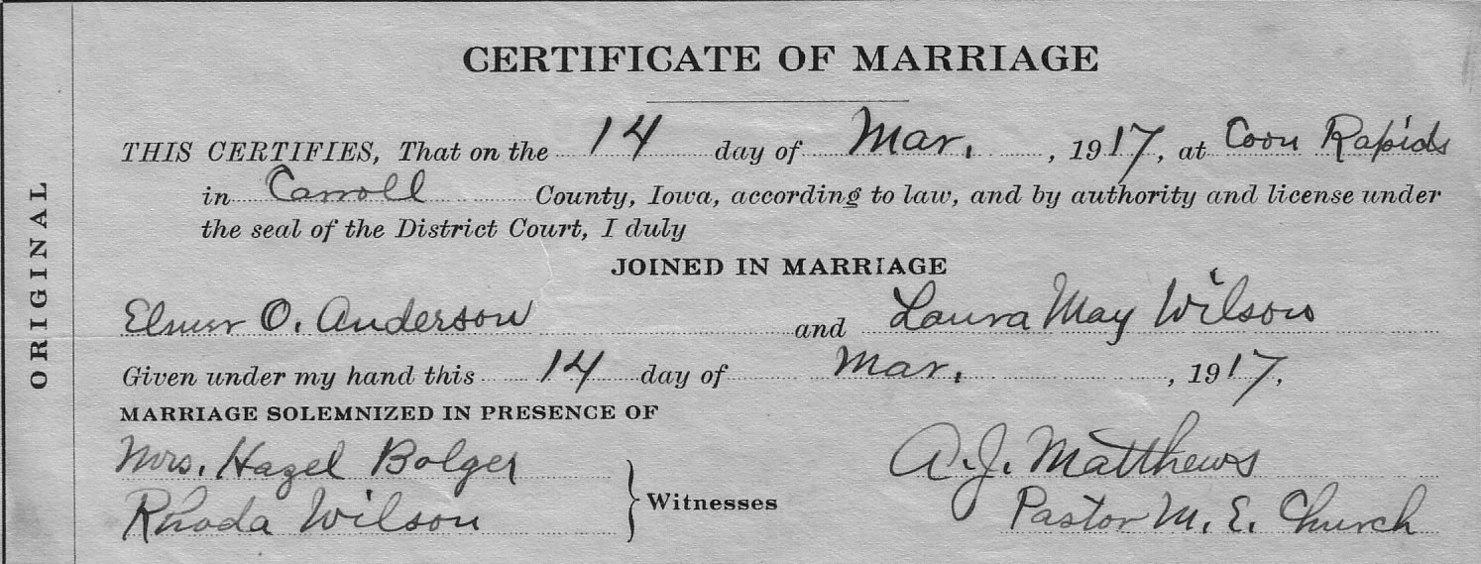

Slide 3
PRIMARY SOURCE

Slide 5
SECONDARY SOURCE

Slide 7
SECONDARY SOURCE

Slide 8
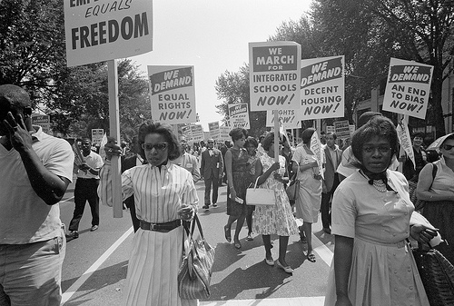

Slide 9
PRIMARY SOURCE

Slide 11
SECONDARY SOURCE

Slide 13
PRIMARY SOURCE

Slide 14
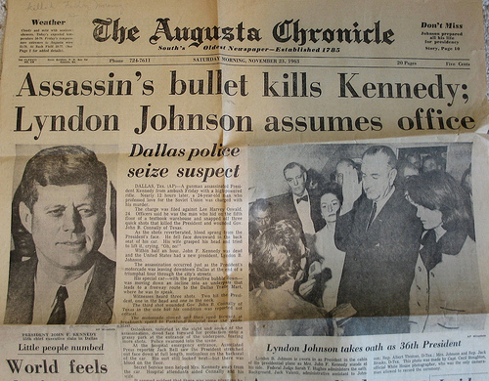

Slide 15
PRIMARY SOURCE

Slide 17
PRIMARY SOURCE

Slide 19
SECONDARY SOURCE

Slide 21
SECONDARY SOURCE

Slide 22
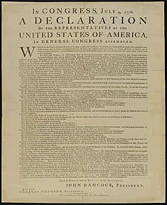

Slide 23
PRIMARY SOURCE

Slide 24
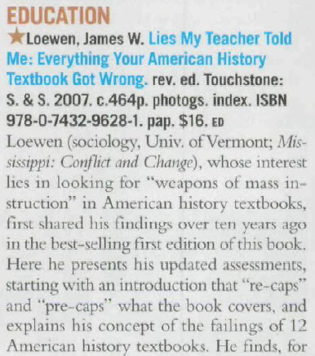

Slide 25
SECONDARY SOURCE

Slide 26
A YouTube video describing how the pyramids were built.

Slide 27
SECONDARY SOURCE

Slide 28
A radio broadcast from the day the Soviet Union launched Sputnik.

Slide 29
PRIMARY SOURCE

Slide 30
A scientist explaining what it was like for Buzz Aldrin to walk on the moon.

Slide 31
SECONDARY SOURCE

Slide 33
SECONDARY SOURCE

Slide 34
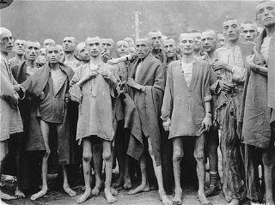

Slide 35
PRIMARY SOURCE

Slide 36
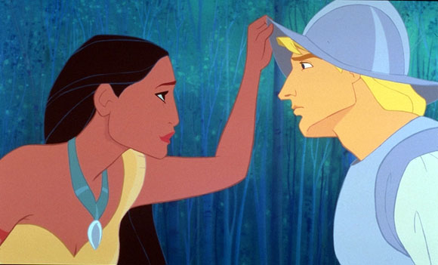
A cartoon showing how Pocahontas met John Smith.

Slide 37
SECONDARY SOURCE

Slide 38
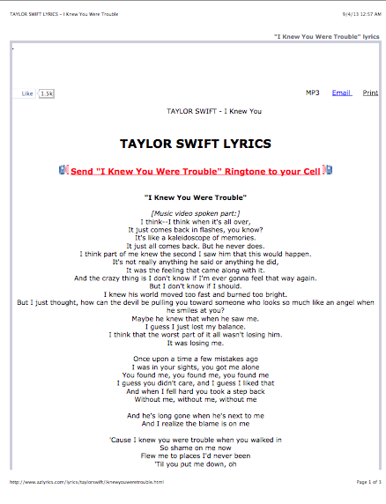

Slide 39
PRIMARY SOURCE

Slide 40
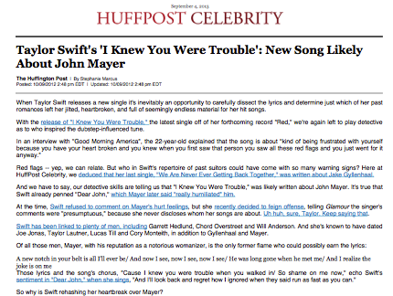

Slide 41
SECONDARY SOURCE

